Slide 1

CMSC 137
Data Communications and Networking
Lecture Module
02 – The Internet

Slide 2
Module 2: The Internet
Rozano S. Maniaol
Lecturer

Slide 3
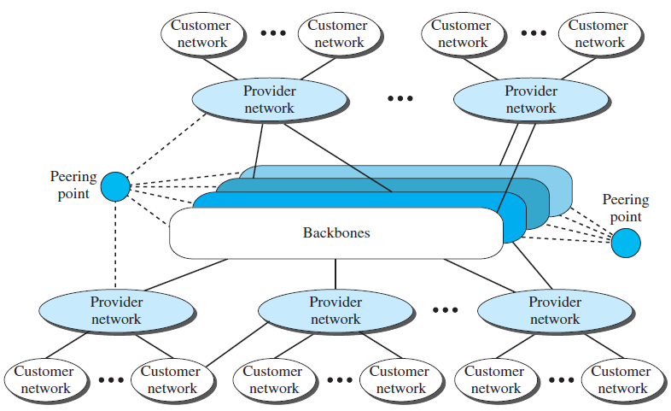
The Internet

Slide 4
The Internet
Backbones – large networks owned by communication companies
Peering points – complex switching systems
Provider networks – uses the service of the backbone for a fee
Customer networks (at the edge) – actually uses the services provided by the Internet
Backbones and provider networks are also called Internet Service Providers (ISPs)
  Backbones (international ISP); Provider networks (national or regional ISPs)

Slide 5
Accessing the Internet
Using telephone networks
  Dial-up service
  DSL service
Using cable networks
Using wireless networks
Direct connection to the Internet

Slide 6
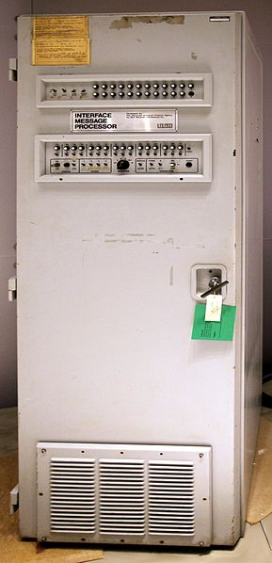
History
Mid-1960's – computers are standalone
Advanced Research Projects Agency (ARPA) was interested in finding a way to connect computers to reduce cost and eliminate duplication of efforts
1967 – at an ACM meeting, ARPA presented ARPANET
  small network of computers which used Interface Message Processors (IMP)
https://commons.wikimedia.org/wiki/File:ARPANET_first_router_2.jpg

Slide 7
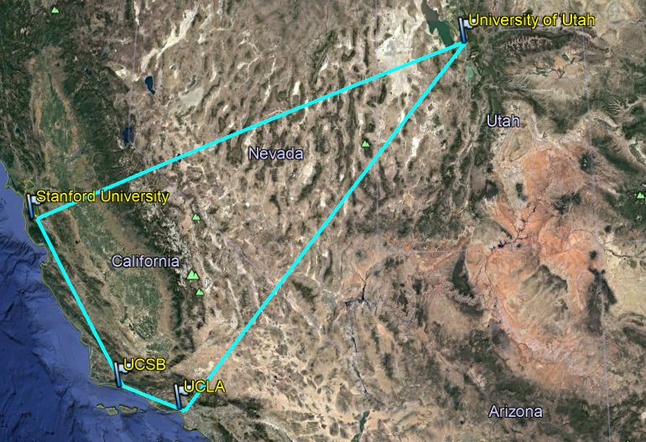
History
University of California at Los Angeles (UCLA), University of California at Santa Barbara (UCSB), Stanford Research Institute (SRI), and University of Utah connected in December 1969 via software called Network Control Protocol (NCP)

Slide 8
History
1972 – Vint Cerf and Bob Kahn worked on the Internetting Project
1973 – paper on Transmission Control Protocol (TCP)
  Protocol to achieve end-to-end delivery, encapsulation, the datagram and functions of a gateway
Original TCP was split into two: TCP and IP
  TCP responsible for higher level functions such as segmentation, reassembly and error detection
  IP handles datagram routing

Slide 9
History
1981 – Computer Science Network (CSNET) was created for those ineligible to join ARPANET
1983 – ARPANET split into two networks: Military Network (MILNET) and ARPANET (nonmilitary use)
1986 – NSF sponsored the National Science Foundation Network (NSFNET), a backbone that connected 5 supercomputer centers located throughout the US
  Officially replaced ARPANET in 1990
1991 – IBM, Merit and Verizon formed Advanced Network & Services (ANS) and build a new high speed Internet backbone called Advanced Network Service Network (ANSNET)

Slide 10
The Internet: Today
Set of pier networks that provides services to the world
World Wide Web – invented at CERN by Tim Berners-Lee
Multimedia – voice over IP (telephony), video over IP (like Skype), view sharing (like YouTube), television over IP (like PPLive)
Peer-to-peer applications

Slide 11
Autonomous Systems

Slide 12
Autonomous System (AS)
Collection of routers whose prefixes and routing policies are under common administrative control (SINGLE and CLEARY DEFINED routing policy) [RFC 1930]
Could be an ISP, a large company, a group of companies or a university
Represents a connected group of one or more blocks of IP addresses, called IP prefixes, that have been assigned to that organization and provides a single routing policy to systems outside the AS
Ex. AS45209 – UPLB’s ASN, with IPv4 prefix 202.92.144.0/22

Slide 13
Peering vs Transit
Peering – two or more autonomous networks interconnect directly with each other to exchange traffic
Transit – one autonomous network agrees to carry traffic that flows between another autonomous network and all other network
In peering, two ISPs only exchange the routes of their downstream customers and neither can see the upstream routes over peering connection. Because transit is a paid service, the provider will provide routes to the rest of the Internet, including their downstream partners, other peers and upstream providers

Slide 14

Peering vs Transit
Transit
Provider A
Backbone
Provider C
IXP
Provider E
Peering
Provider B
IXP
Backbone
Provider D
Provider F

Slide 15
Submarine Cables

Slide 16
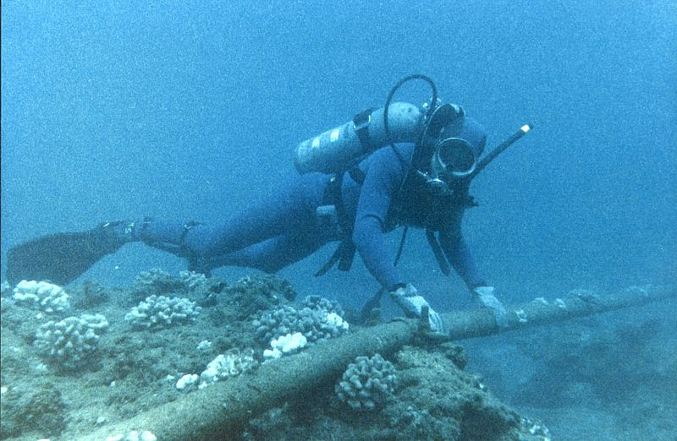
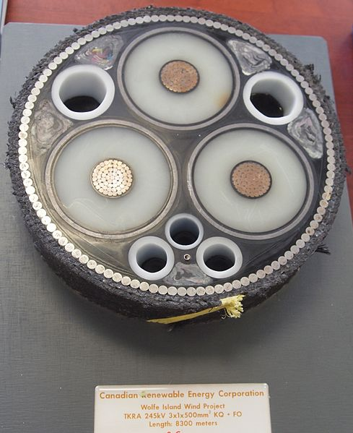
Submarine Cables
First laid in the 1850s carrying telegraphy traffic, establishing the first instant links between continents. Subsequent generations carried telephone traffic then data communications traffic
https://commons.wikimedia.org/wiki/File:Wolfe_Island_Wind_Project_Submarine_Power_Cable.jpg
https://commons.wikimedia.org/wiki/File:Diver_Checking_Underwater_Protection_of_Cable_-_Flickr_-_The_Official_CTBTO_Photostream.jpg

Slide 17
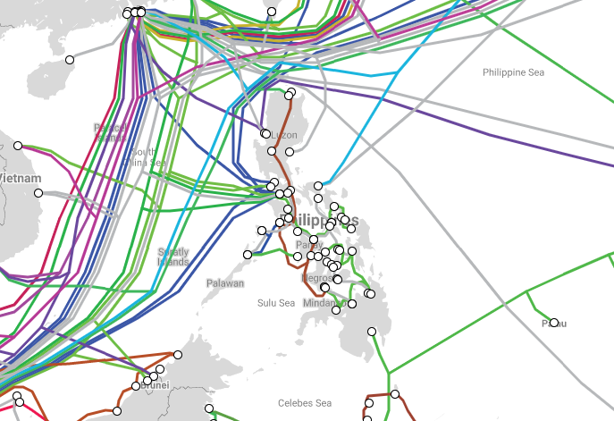
Submarine Cable Map
https://www.submarinecablemap.com/

Slide 18
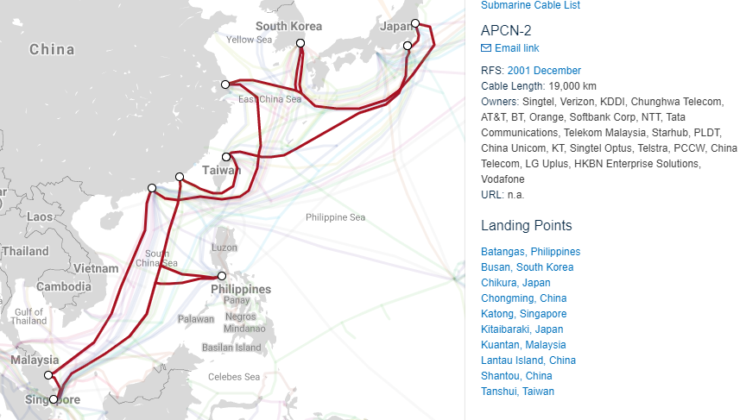
Asia-Pacific Cable Network 2

Slide 19
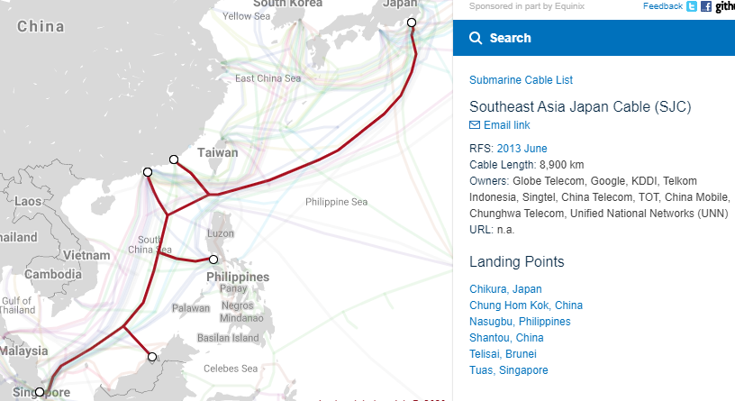
Southeast Asia Japan Cable

Slide 20
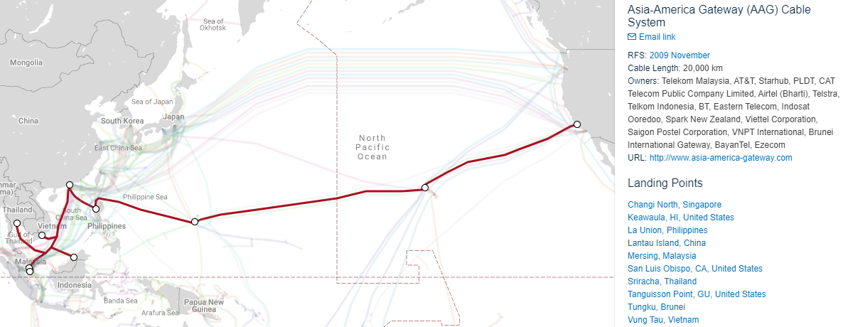
Asia-America Gateway

Slide 21
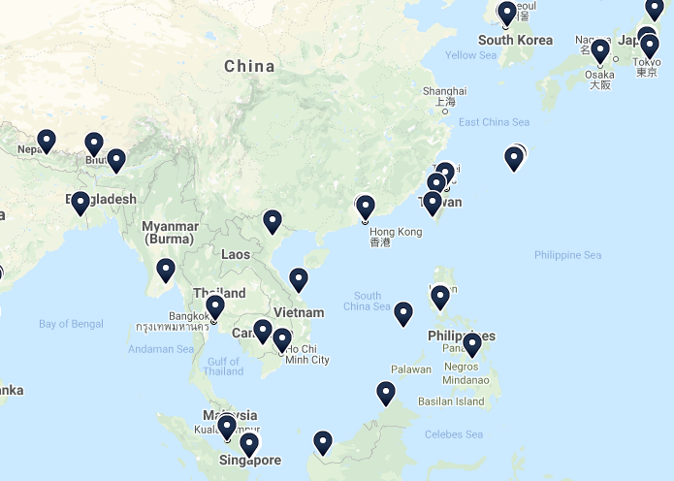
Internet Exchange Points (IXP)
Physical location through which Internet infrastructure companies such as ISPs and content delivery networks (CDNs) connect with each other
https://www.internetexchangemap.com

Slide 22


Without a Local IXP
Internet
Domestic bound internet traffic leaves the country via expensive international transit links
IX
International Network
International Transit
Domestic Network
ISP-A
ISP-B
ISP-A Customers
ISP-B Customers

Slide 23
With a Local IXP
Internet
Domestic bound internet traffic stays within the country
IX
International Network
International Transit
Domestic Network
IX
ISP-A
Domestic Peering
ISP-B
ISP-A Customers
ISP-B Customers

Slide 24
In the Philippines
Philippine Research, Education and Government Information Network (PREGINET) – national research and education network (NREN) that interconnects academic, research and government institutions
[http://pregi.net/]
Philippine Open Internet Exchange (PHOpenIX) – only neutral Internet Exchange in the Philippines
[http://phopenix.net]
Both are being managed by DOST - ASTI

Slide 25
Standards

Slide 26
Protocol
Set of rules that govern data communications
What is communicated, how it is communicated, when it is communicated
Elements
Syntax – structure and format of a data
Semantics – meaning of each section of bits
Timing – when data should be sent and how fast they can be sent

Slide 27
Standards
Creates and maintains an open and competitive market for manufacturers
Guarantees national and international operability of data and telecommunications technology and processes
De facto (“by fact”) – have not been approved by an organized body but have been adopted as standards through widespread use
De jure (“by law”) – have been legislated by an officially recognized body

Slide 28
How are standards developed?
Standard creation committees
  ISO, ITU-T, CCITT, ANSI, IEEE, EIA
  Slow approval process
Forums – speeds up acceptance and use of technology
  Conclusions presented in standards bodies
Government regulatory agencies
  FCC / NTC
  To protect public interest

Slide 29
Internet Standard
A thoroughly tested specification that is useful to and adhered to by those who work with the Internet
Specification begins as an Internet draft
  Work-in-progress, 6-month lifetime
Upon recommendation, may be published as Request for Comment
  Edited, assigned a number, made available to interested parties
  Invented by Steve Crocker to provide record of Network Working Group's (NWG) design of the ARPANET
  RFC 1 - “Host Software”
  RFC 1000 - “Request for Comments Reference Guide”

Slide 30
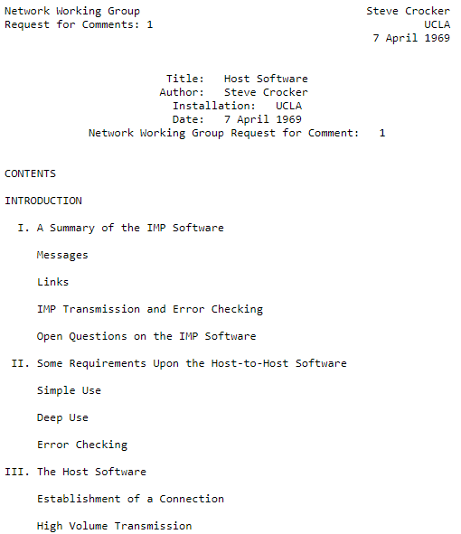
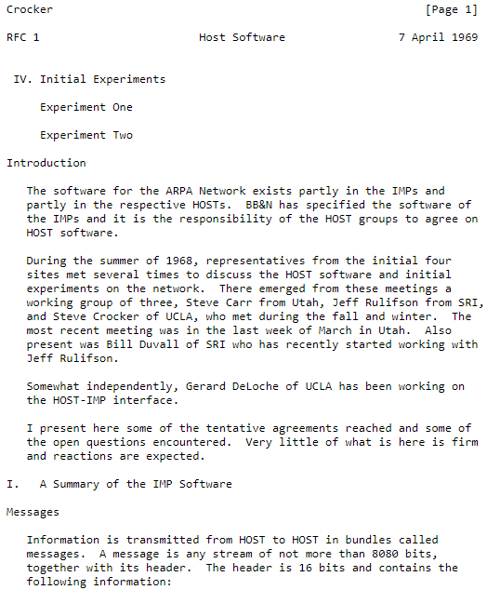
RFC 1

Slide 31
Maturity Levels of an RFC
Internet Draft
Experimental
Proposed Standard
Informational
6 months and 2 trys
Draft Standard
4 months and 2 trys
Internet Standard
Historic

Slide 32
RFC Requirements Level
Required – it must be implemented by all Internet systems to achieve minimum performance (Example: IP, ICMP)
Recommended – not required for minimum conformance; it is recommended for its usefulness (Example: FTP, TELNET )
Elective – not required and not recommended, however a system can use it for its own benefit
Limited Use – should only be used in limited situation; most experimental RFC fall under this
Not recommended – inappropriate for general use; normally historic (deprecated) RFC fall under this

Slide 33
Administration

Slide 34
Internet Administration
Internet Society (ISOC) – international, nonprofit organization formed in 1992 to provide support for the Internet standard process
Internet Architecture Board (IAB) – technical advisor of ISOC. Oversee the continuing development of the TCP/IP Protocol Suite
Internet Engineering Task Force (IETF) – forum of working groups managed by the Internet Engineering Steering Group (IESG). Responsible for identifying operational problems and proposing solutions to these problems
Internet Research Task Force (IRTF) – forum of working groups managed by the Internet Research Steering Group (IRSG). Focuses on long-term research topics

Slide 35
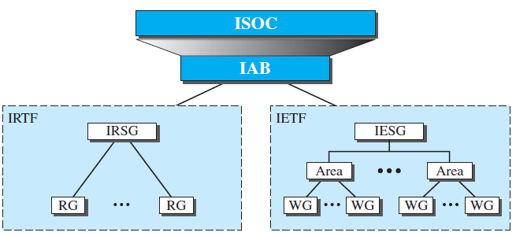
Internet Administration

Slide 36
References
Forouzan, B.A. 2013. Data Communications and Networking, 5th Ed. McGraw-Hill, New York.
Krzyzanowski, Paul. 2016. Understanding Autonomous Systems Routing and Peering. https://www.cs.rutgers.edu/~pxk/352/notes/autonomous_systems.html
Van Der Berg, R. 2008. How the ‘Net works: an introduction to peering and transit. https://arstechnica.com/features/2008/09/peering-and-transit/2/
Cloudflare. What is an Internet exchange point? | How do IXPs work? https://www.cloudflare.com/learning/cdn/glossary/internet-exchange-point-ixp/
Telstra Global. July 2015. Peering Vs. Transit. https://www.telstraglobal.com/insights/blogs/blog/peering-vs-transit

